Slide 1


Anatomy of the Thoracic Spine
PT5050
Chris Phillips

Slide 2
CONTENTS
Lx recap
Describe the structure of the thoracic spine
Identify how the thoracic spine differs to lumbar
Clinical application
  Thoracic spine pathology
  BPS concepts related to thoracic spinal pain

Slide 3

Mentimeter - 6962 5623

Slide 4
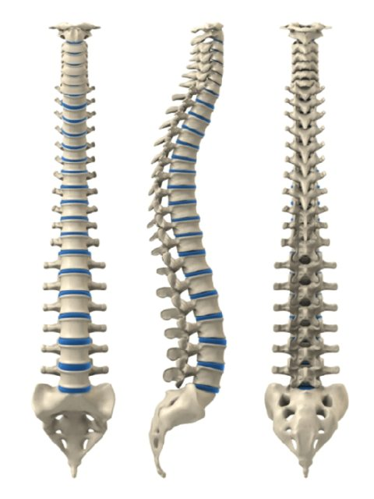
Functions of the spine
Support
Movement
Protection

Slide 5
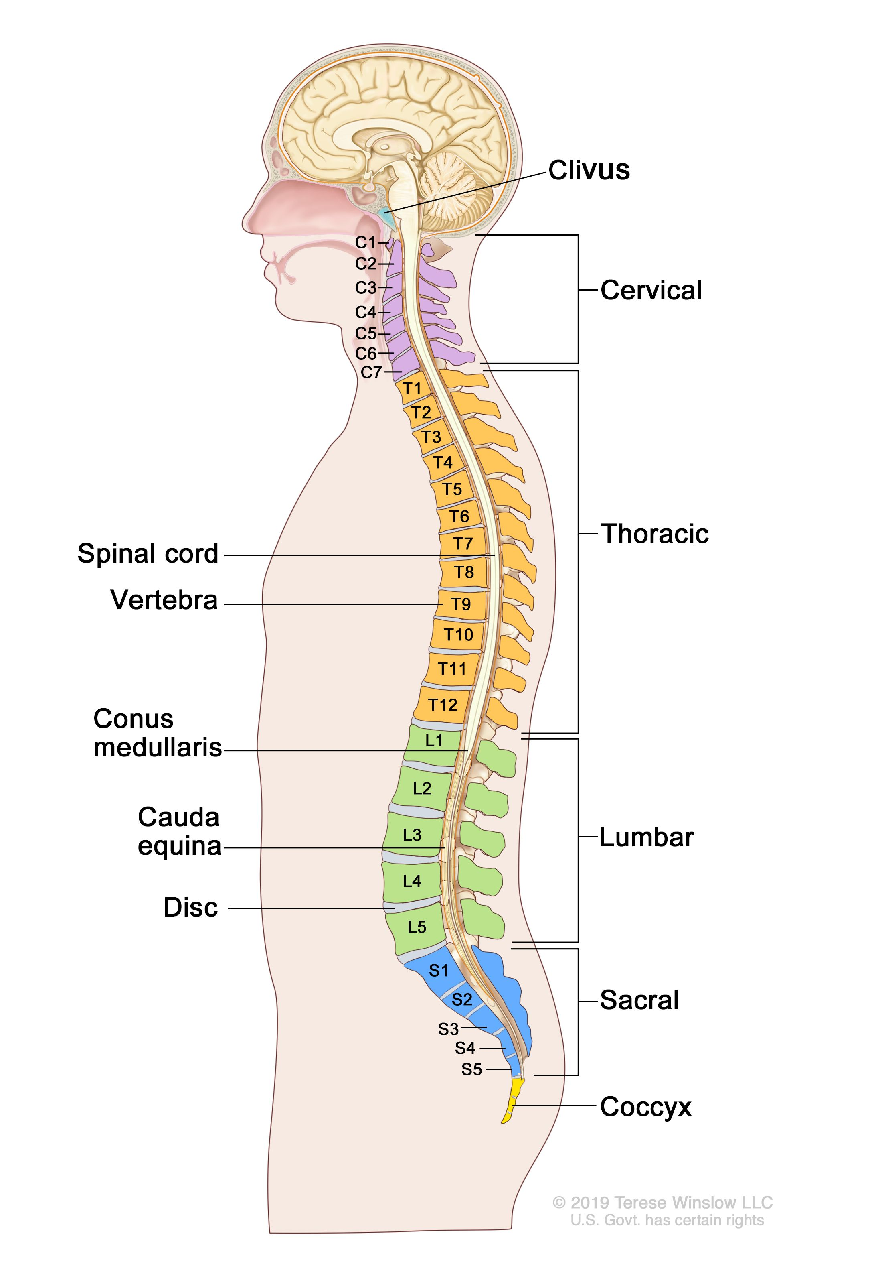
Cervical – 7 vertebrae
C1-C7
Thoracic – 12 vertebrae
T1-T12
Lumbar – 5 vertebrae
L1-L5
Sacral – 5 fused vertebrae
S1-S5

Slide 6
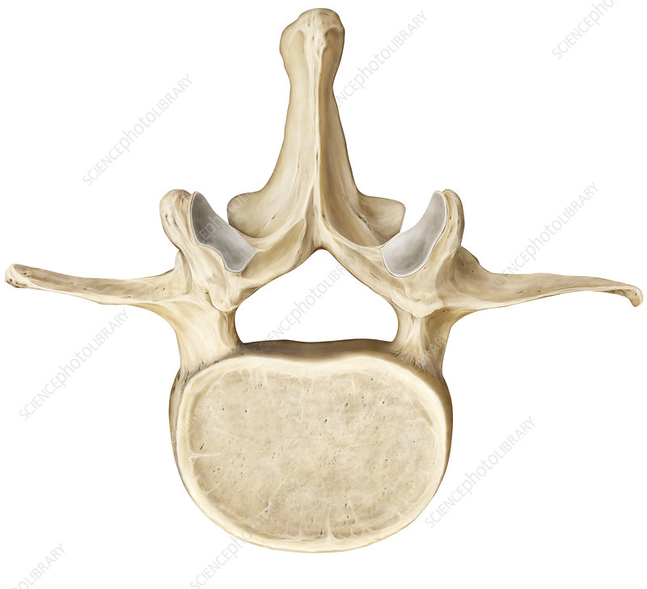
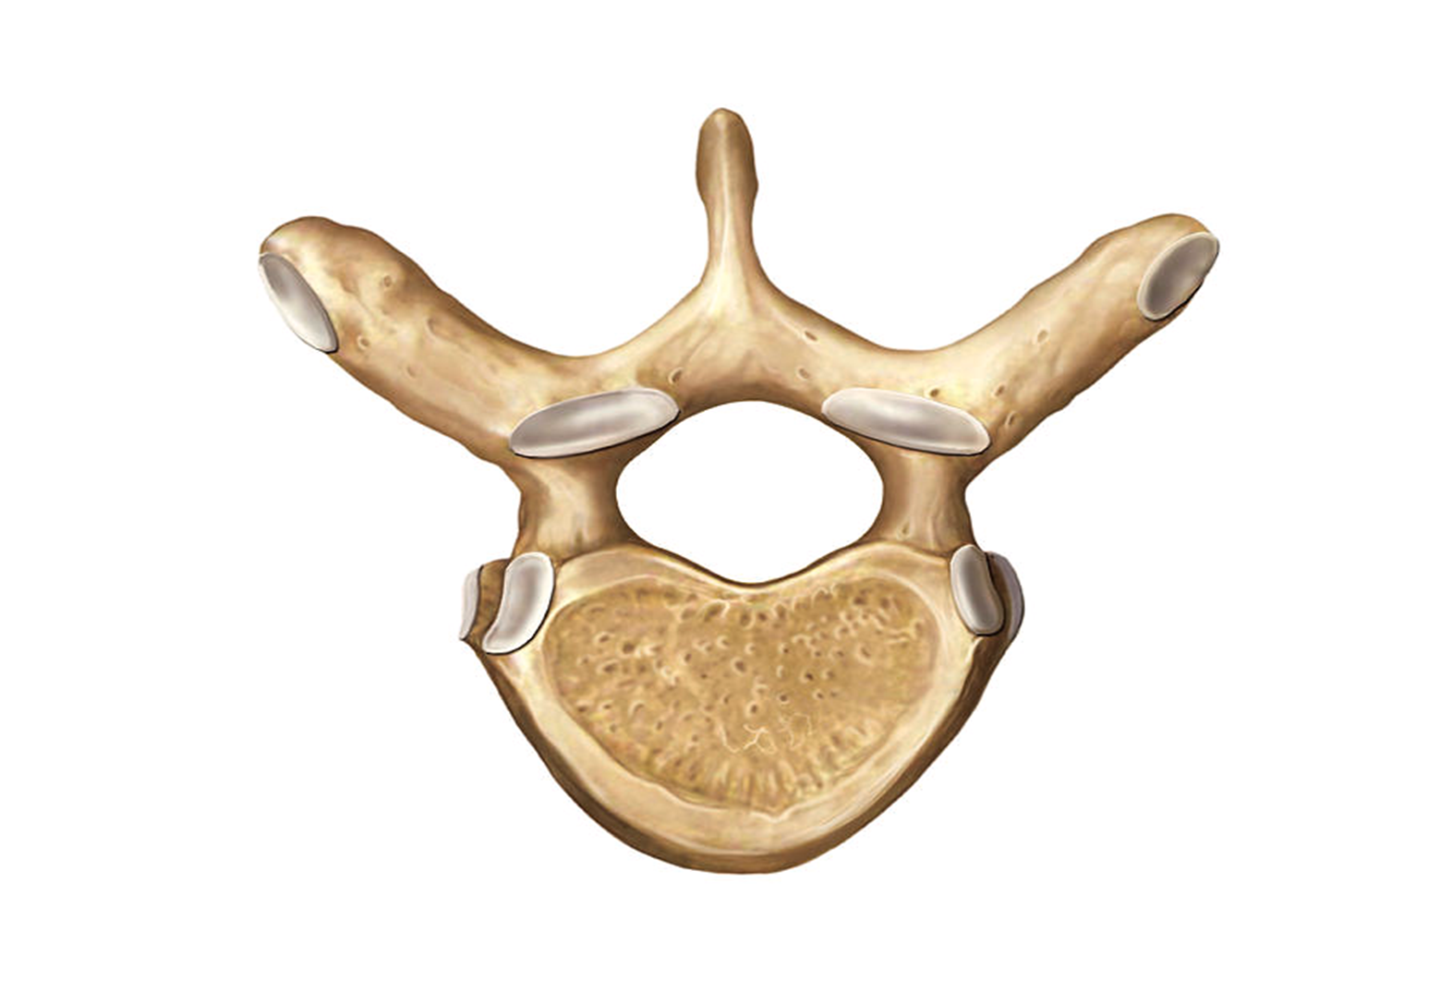
Task
In small groups
  Identify difference between the lumbar and thoracic vertebrae

Slide 7
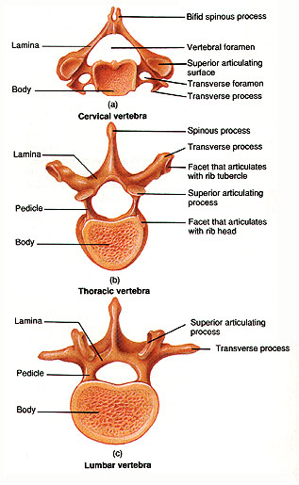
Thoracic vertebrae
Described as ‘typical’ and ‘atypical’
  Typical = T2-9
  Atypical = T1,10,11,12
  T5-8 most typical of Tx
Heart shaped body (smaller than Lx)
Smaller circular vertebral canal
Transverse process extend posterolaterally (length decreases T1-12)
Facet joints lie anterior to TP

Slide 8
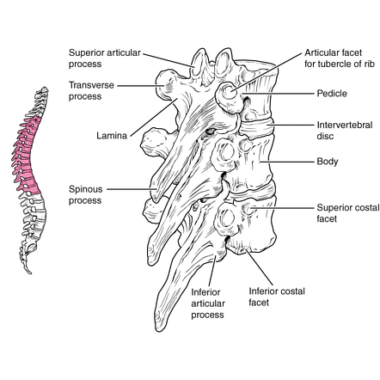
Spinous Process
Long spinous processes that slope in a posteroinferior direction
Can extend to the vertebrae below
Palpation of the transverse processes in the thoracic region is notoriously difficult due to anatomical variation

Slide 9
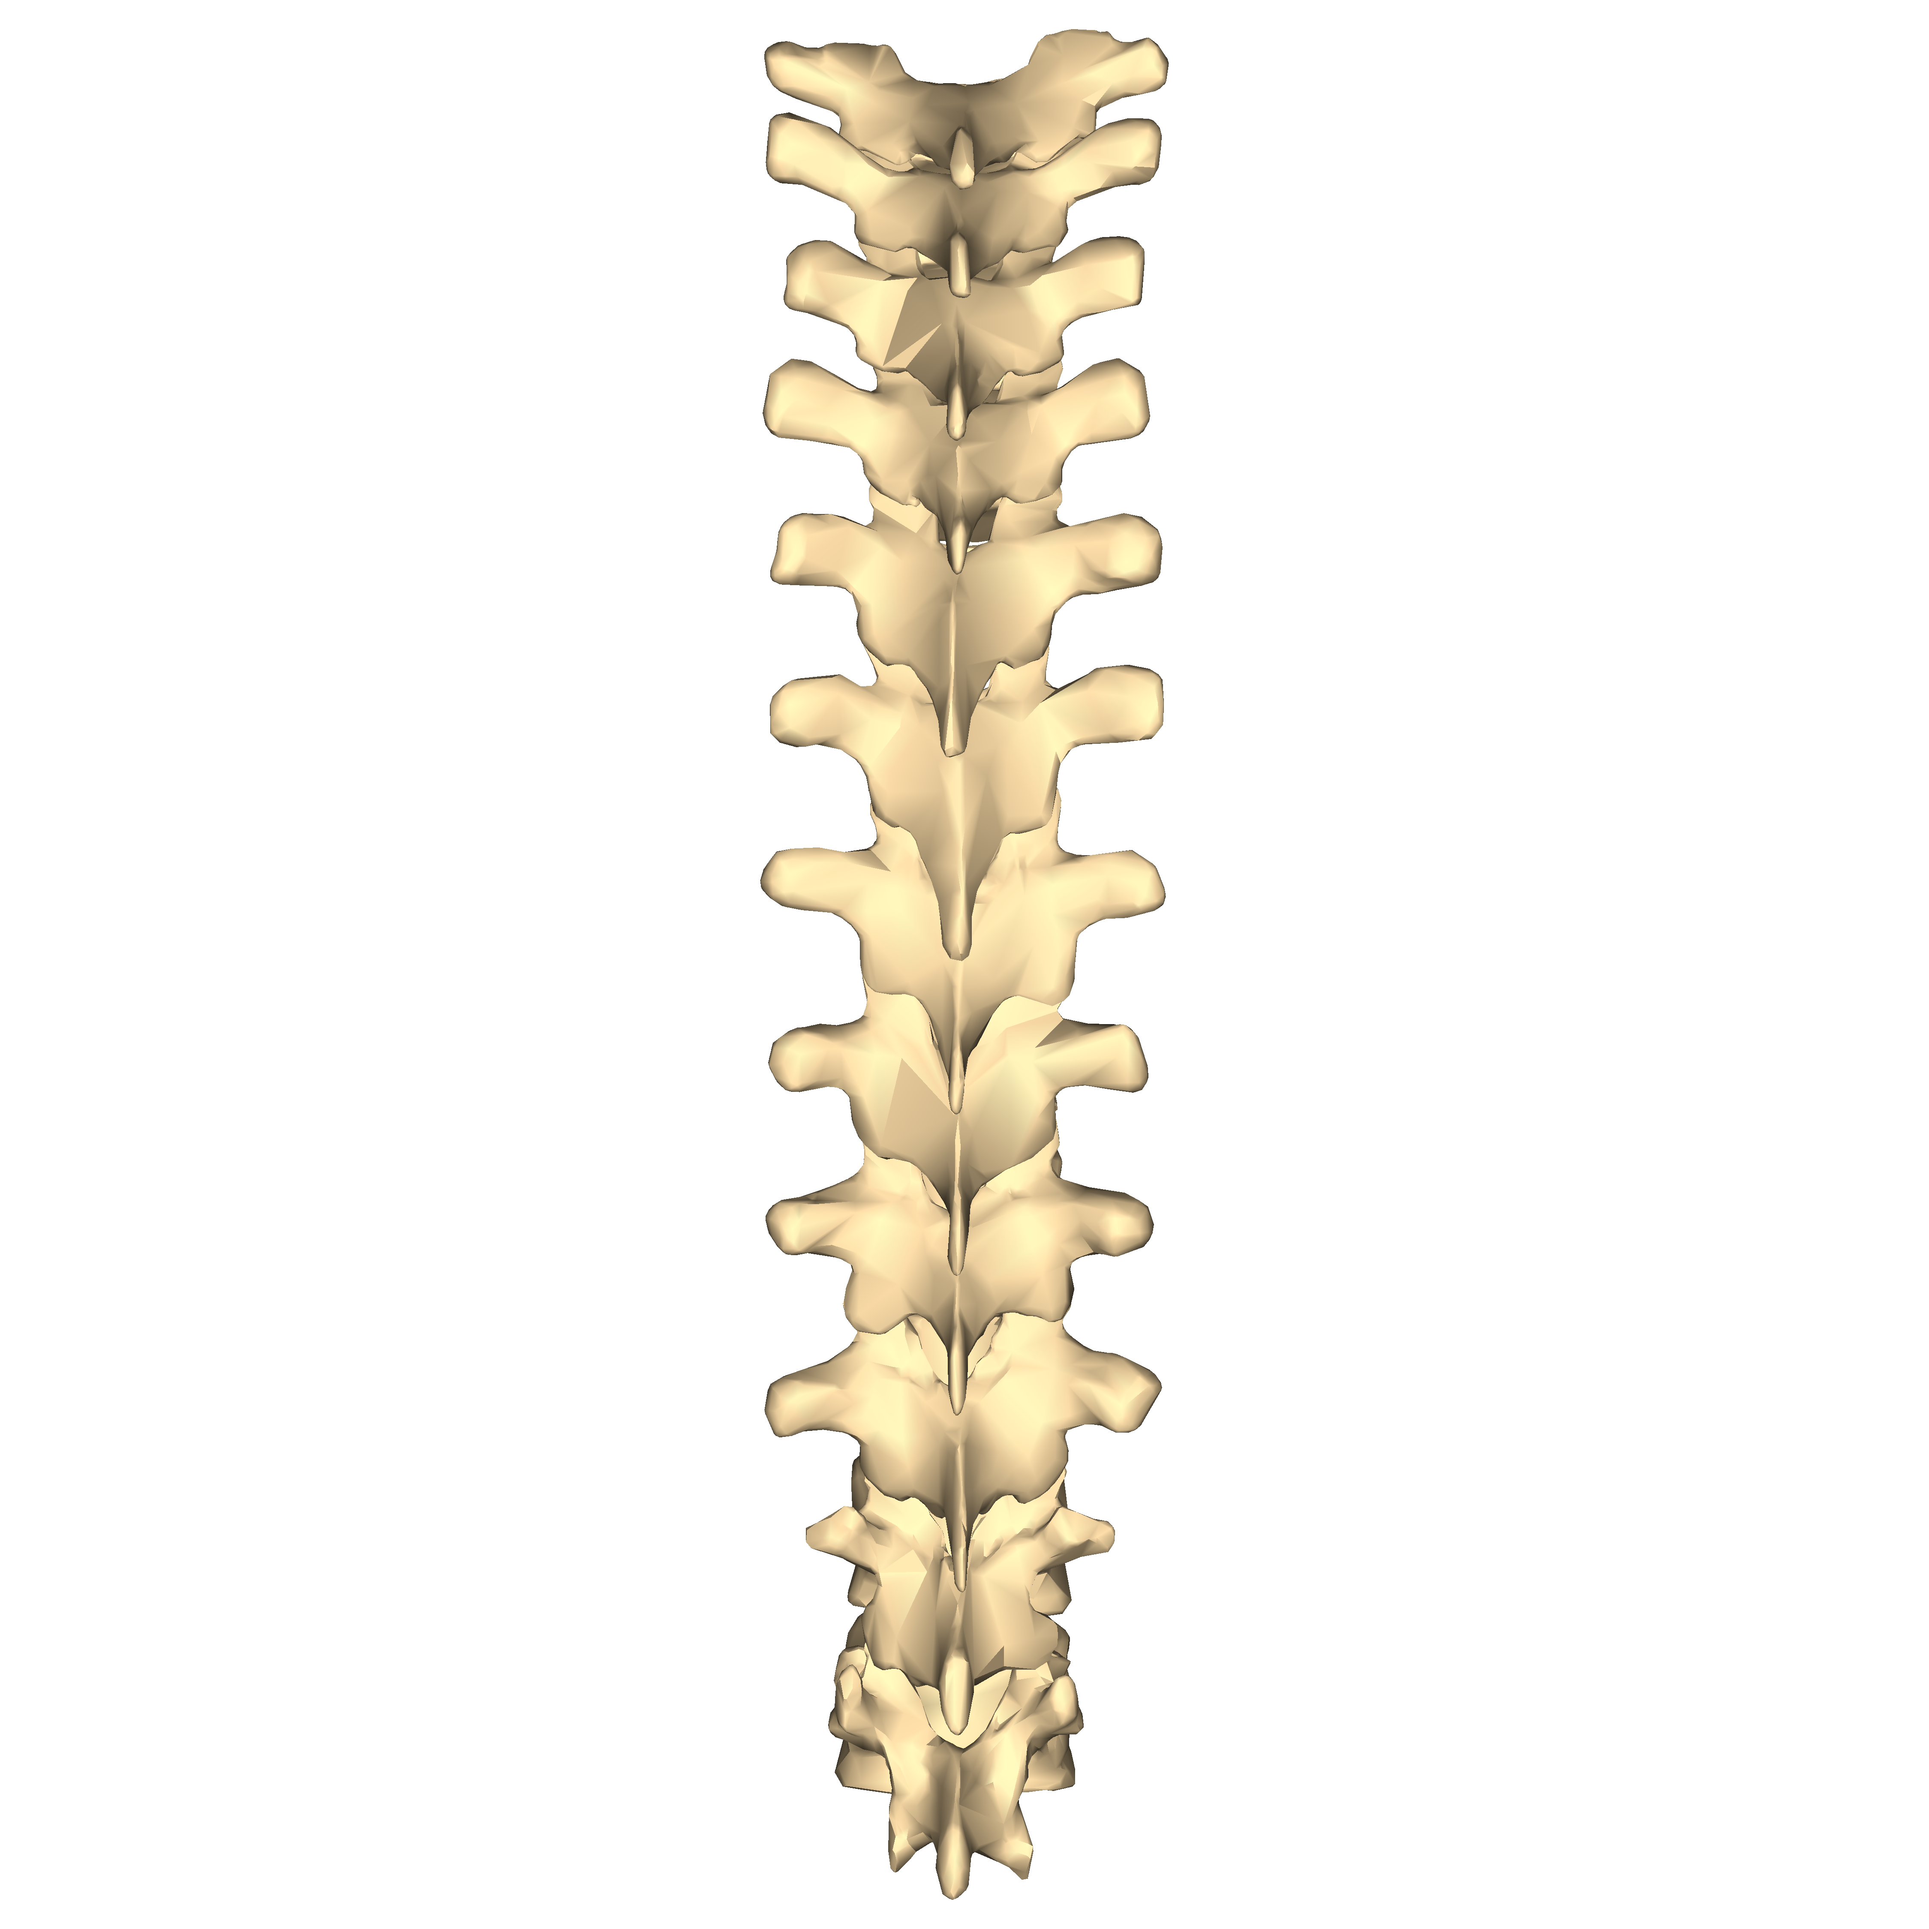
In 1979, Mitchell proposed a so-called ‘rule of three’
  1st group of 3 spinous processes (T 1-3) are level with vertebral body of the same level
  2nd group of 3 spinous processes (T 4-6) are level with the disc of the inferior level (HALF WAY DOWN)
  3rd group of 3 spinous processes (T 7-9) are level with the vertebral body of the level below (SO ONE DOWN)
  T10 one down (as T7-9)
  T11 half way down (as T4-6)
  T12 same level (as T1-3)

Slide 10
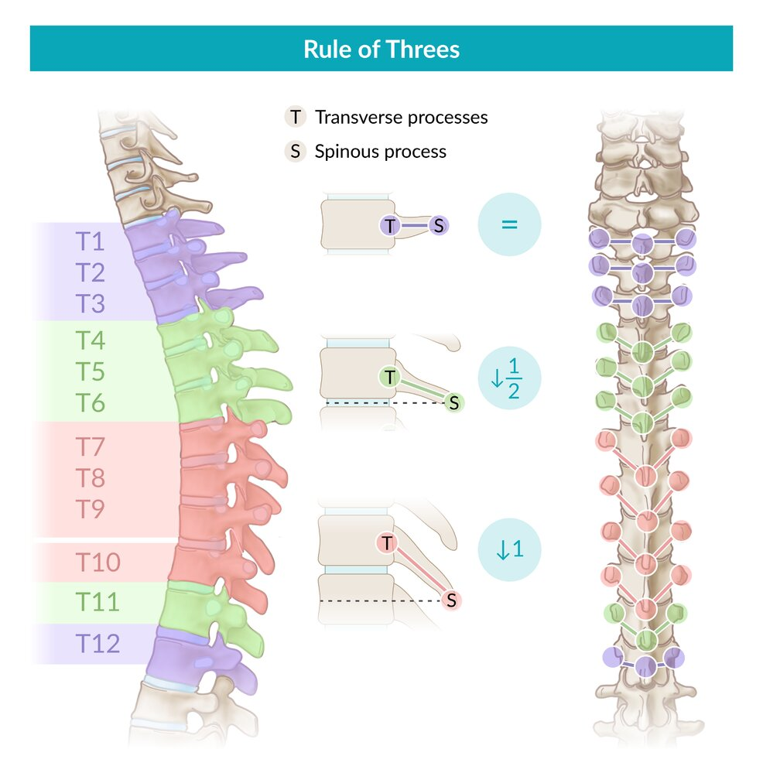

Slide 11
However
  Geelhoed et al. (2006) dissected 15 cadavers and measured the vertical distance between the transverse plane of the transverse processes of 1 vertebra and the spinous processes for all levels of the thoracic spine
  They concluded that the “transverse processes of each thoracic vertebra are generally at the level of the spinous processes of the vertebra 1 level above, throughout the thoracic spine”

Slide 12
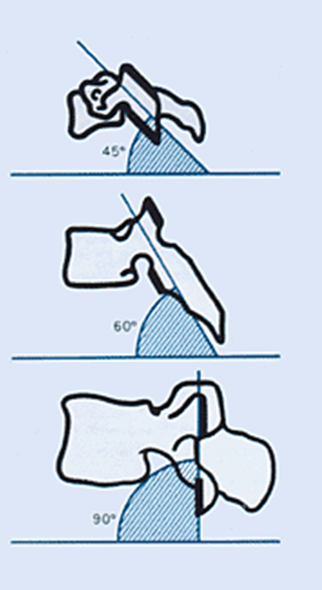
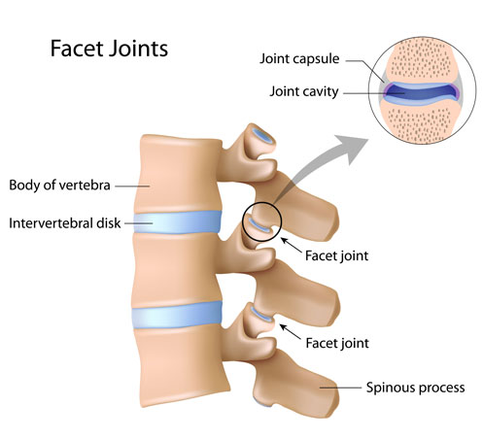
Thoracic facet joints

Slide 13
Thoracic facet joints
Facet joints project almost vertically
Superior facets face posteriorly – inferior face anteriorly
Restrict flexion and extension

Slide 14
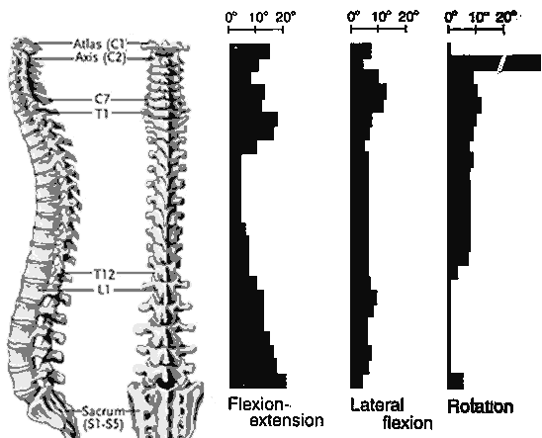

Slide 15
Thoracic vertebrae movement
Angle of facet joints restrict flexion/extension and anterior translation of vertebral segment
  1-2° of extension is available at each thoracic segment, giving an overall average of 15-20° of thoracic extension for the entire thoracic spine
  Tight to protect organs but loose enough to allow respiratory movement
Narrow disc compared to vertebrae body
Presence of thoracic cage (ribs, sternum, costal cartilage, ligaments)

Slide 16
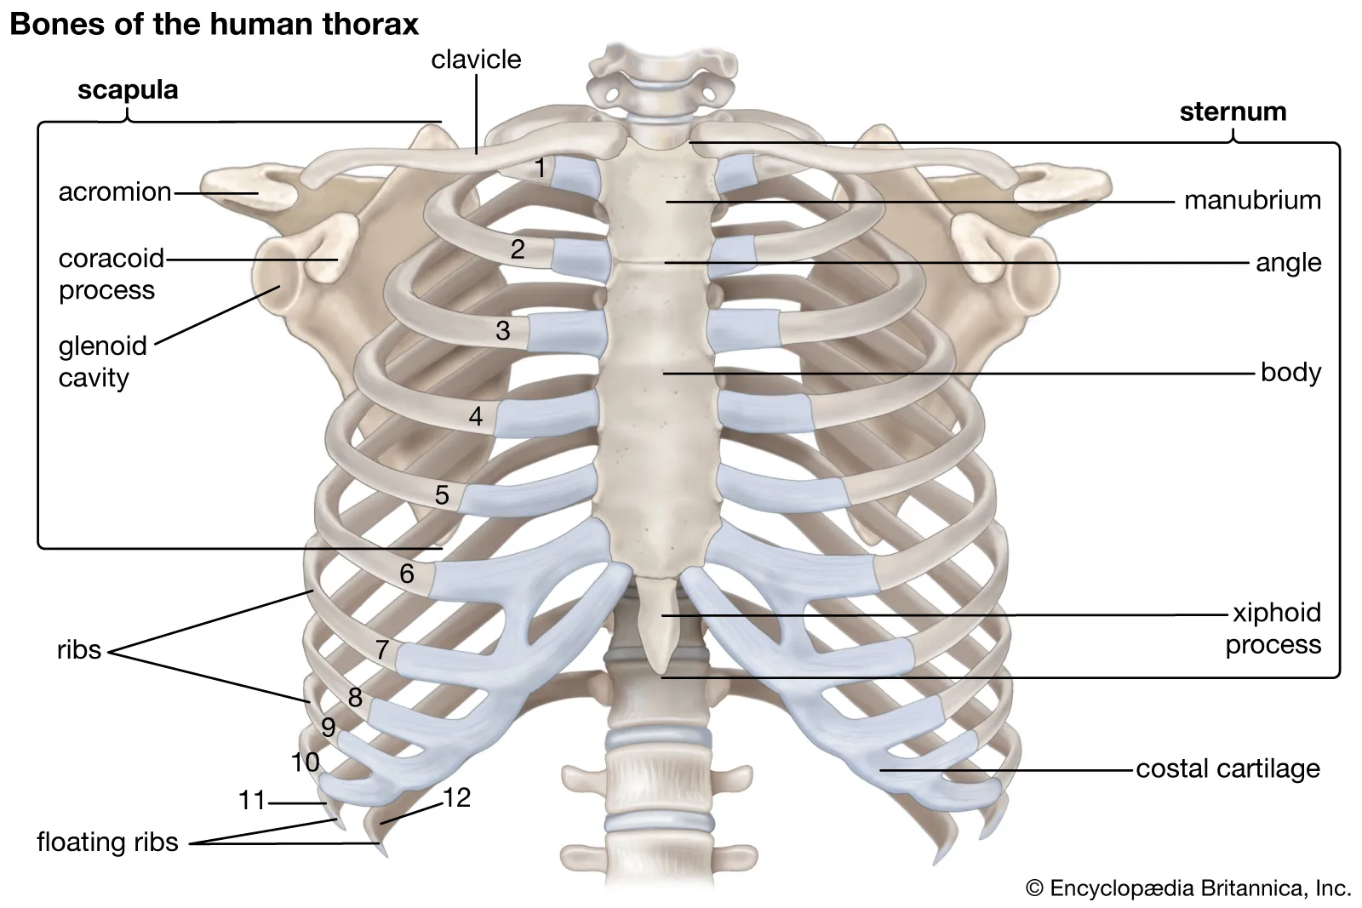
Sternocostal

Slide 17
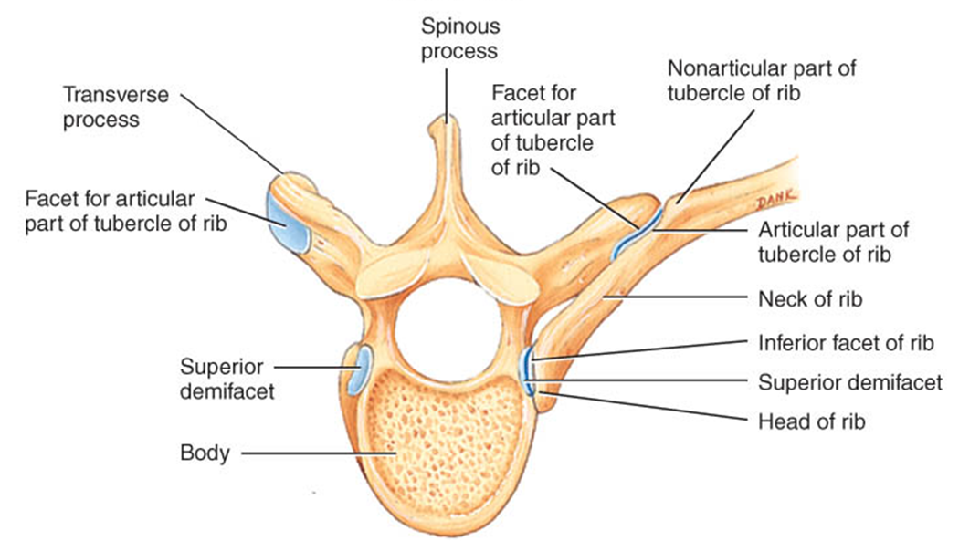
C
Costotransverse
Costovertebral

Slide 18
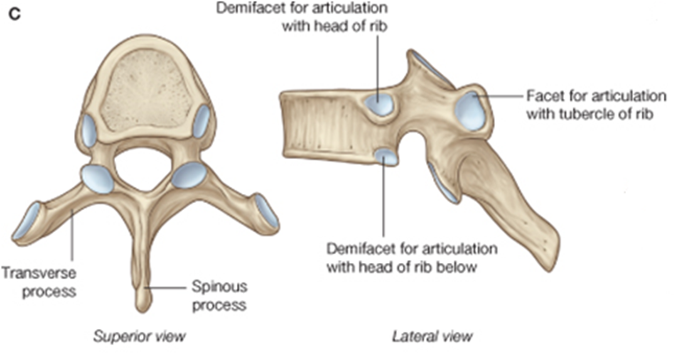
Thoracic vertebrae – rib articulation
6 Costal facets
Facet on the TP for rib articulation
Demi-facets on vertebral body
  Superior facets and inferior facets
*T1 whole superior facet with inferior demi-facet
*T11-12 have 1 whole facet on body and no facet on TP

Slide 19
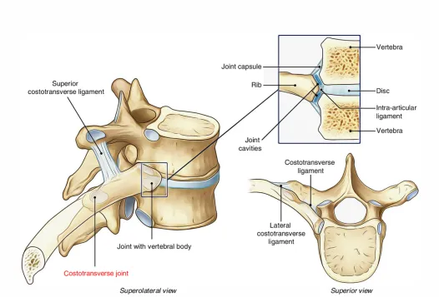

Slide 20
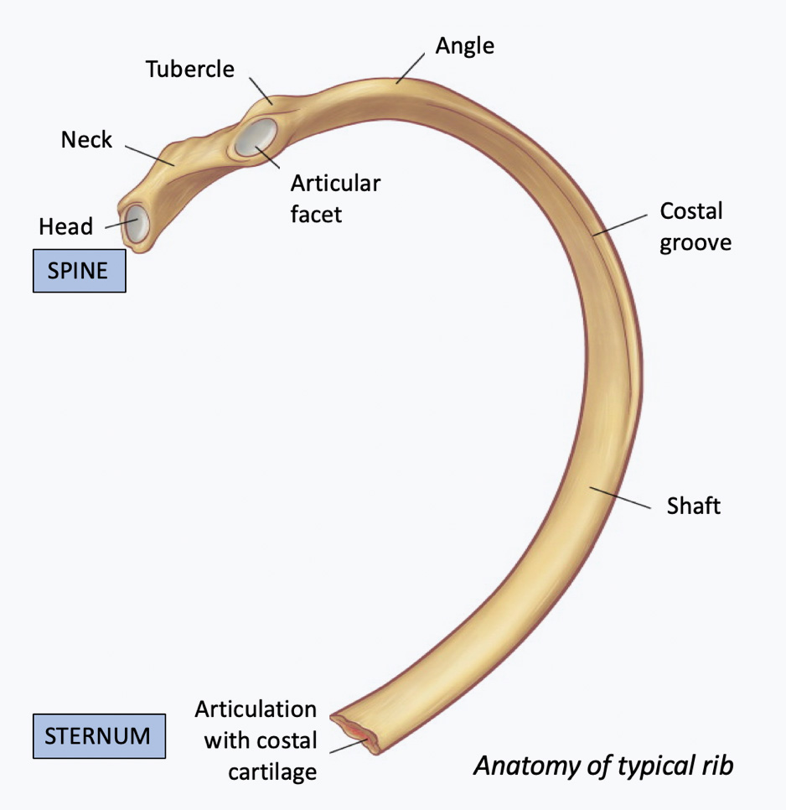
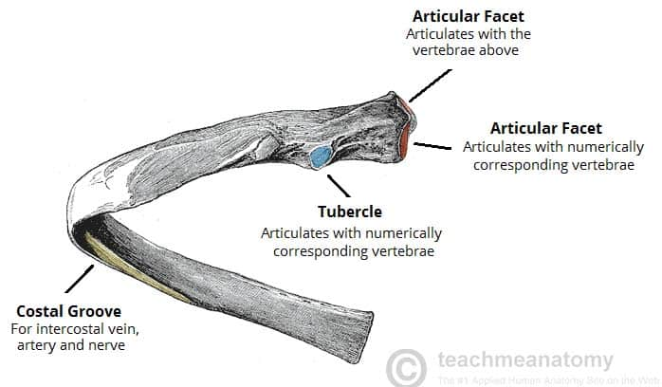

Slide 21
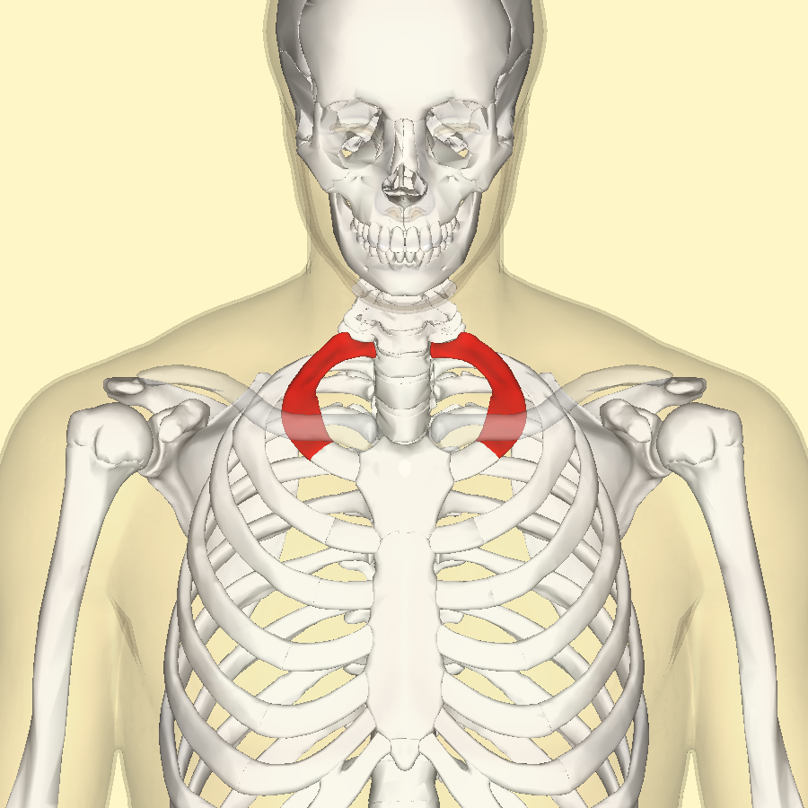
1st rib - atypical
Wide and short with no rib angle
Only articulates with one vertebrae (T1)
Insertion point for scalenes
Makes up the ‘thoracic outlet’
  Anterior scalene
  Middle scalene

Slide 22
Other atypical ribs
2nd rib – Thinner and longer than 1st rib, upper surface is origin for serratus anterior. Two articular facets on head as normal.
10th rib – only one facet, only articulates with T10.
11th and 12th rib – no neck and only one facet. Short ribs that do not attach to sternum (floating ribs).

Slide 23
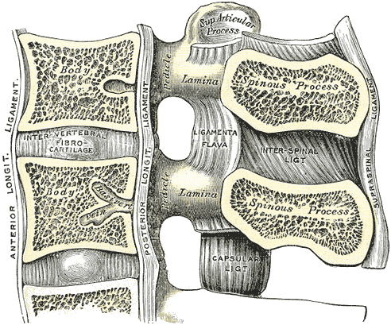
Ligaments of the spine
Anterior longitudinal ligament
Posterior longitudinal ligament
Supraspinous ligament
Interspinous ligament
Ligamentum flavum

Slide 24
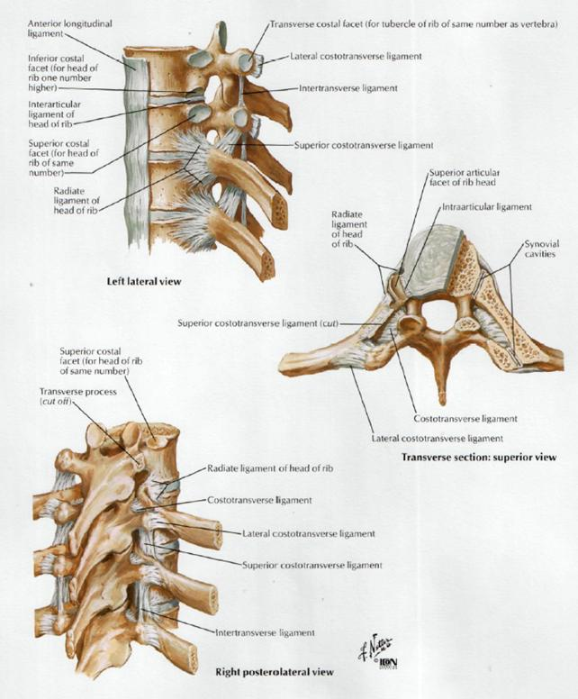
Thoracic ligaments
Radiate ligament of head of rib
  head of rib to vertebral bodies and disc
Costotransverse ligament
  neck of rib to TP
Lateral costotransverse ligament
  TP to tubercle of rib
Superior costotransverse ligament
  neck of rib to TP of vertebrae above

Slide 25
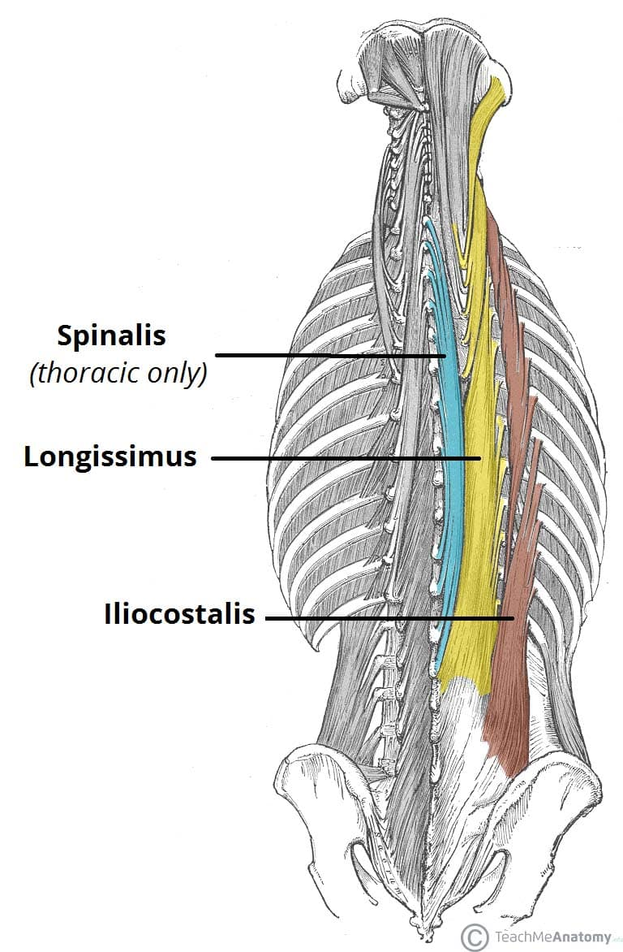
Musculature – Erector Spinae
Spinalis thoracis
Action: Thoracic extension
Origin: Spinous processes of T11-L2
Insertion: Spinous processes of T2-T8
Innervation: Dorsal rami of T4-L1
Longissumus thoracis
Action: Thoracic extension & lateral flexion
Origin: SP & TP of L1-L5, lumbrosacral aponeurosis
Insertion: Thoracic TP & lower 10 ribs
Innervation: Doral Rami T7-L5

Slide 26
Musculature
Iliocostalis thoracis
Action: Thoracic extension & lateral flexion
Origin: Angle of ribs 6-12
Insertion: Angles of ribs 1-6 & TP of C7
Innervation: Dorsal rami of thoracic nerves

Slide 27
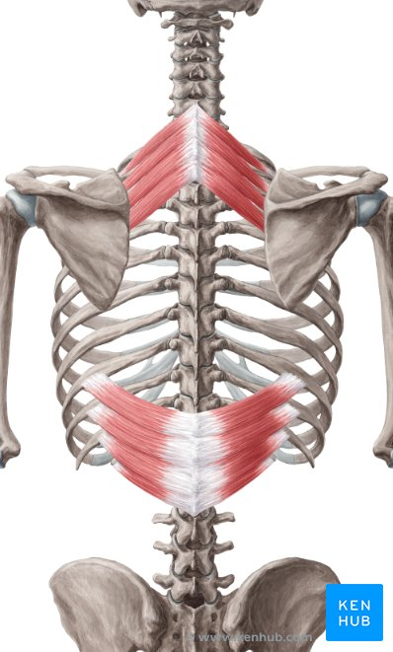
Musculature
Serratus posterior superior
Action: Elevates ribs
Origin: SP of C7-T3
Insertion: Upper border of 2nd-5th ribs
Innervation: Ventral rami of T1-T5
Serratus posterior inferior
Action: Depresses ribs
Origin: SP of T11-L2
Insertion: Lower border of 9th-12th ribs
Innervation: Ventral rami of T9-T12

Slide 28
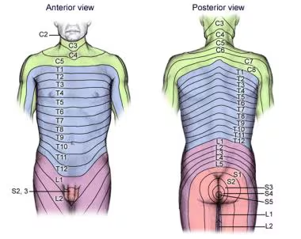
Neural Pathways
Thoracic Spinal Nerves
After exiting the intervertebral foramina, each nerve splits into:
  Dorsal ramus → innervates deep back muscles and skin over thoracic spine.
  Ventral ramus → forms intercostal nerves (T1–T11) and subcostal nerve (T12).
    These supply intercostal muscles, abdominal wall, and thoracic skin.
Dermatomes
Thoracic dermatomes are clinically important for sensory mapping:
  T1: Medial arm
  T4: Nipple line.
  T6: Xiphoid process.
  T10: Umbilicus.
Useful for assessing thoracic radiculopathy or spinal cord injury.

Slide 29
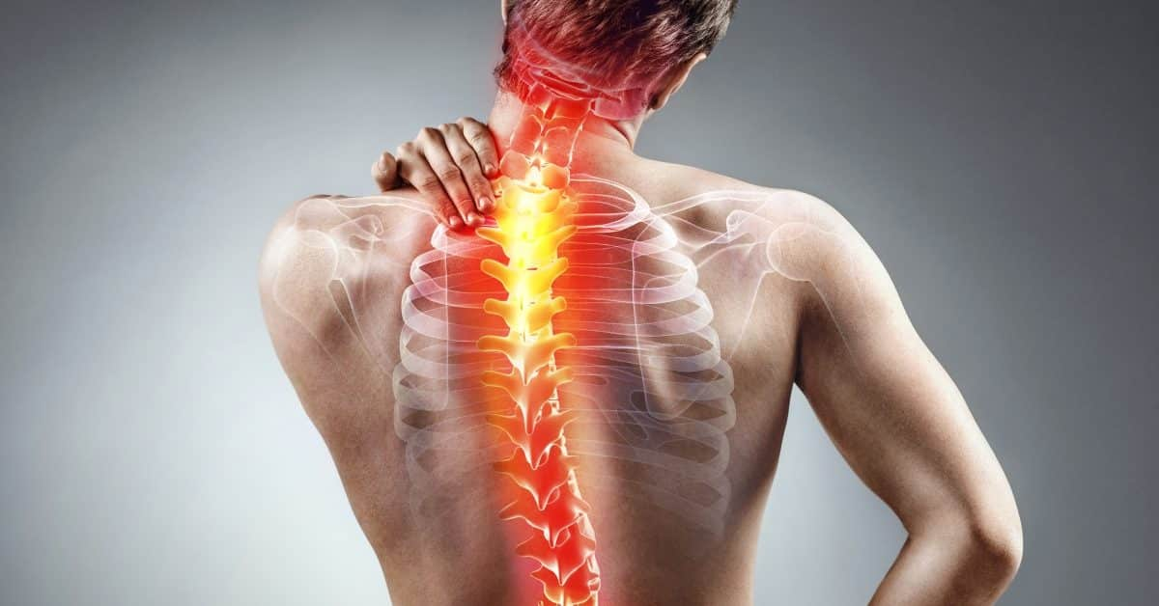
Clinical Application
Thoracic Spine Pathology

Slide 30
Intervertebral Discs
Narrow discs compared to vertebral body
  Cervical ̴40%
  Thoracic ̴20%
  Lumbar ̴33%
Disc pathology is rare in thoracic spine and often found incidentally
  0.25-0.75 of all symptomatic disc herniation
  (Fogwe, Zulfiqar & Mesfin, 2025)
Can cause radicular pain often following dermatome pattern.
Myelopathy – compression of spinal cord

Slide 31
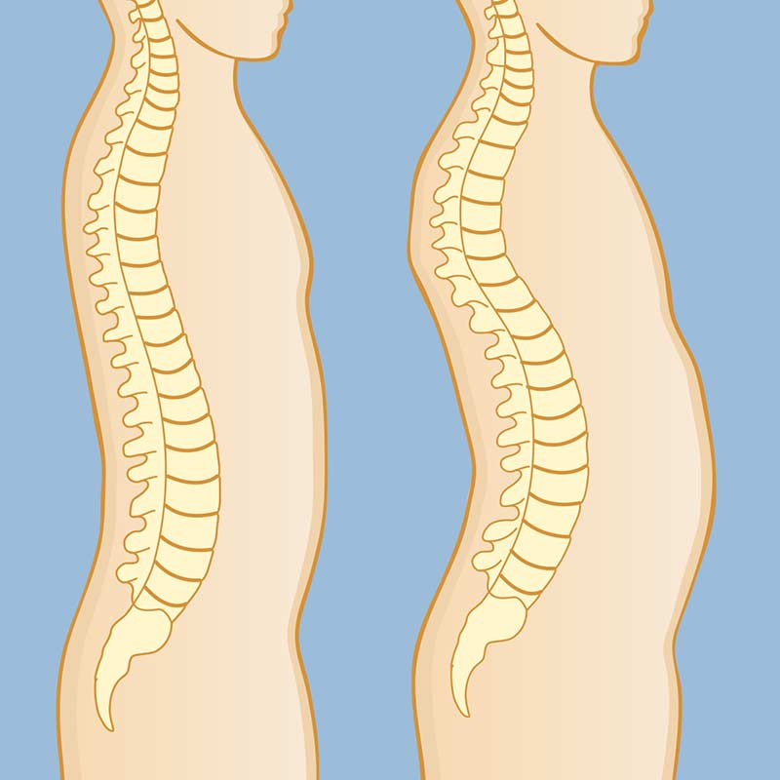
Thoracic Spine
Kyphotic curve rather than lordotic
  Due to shape of vertebrae and disc
Curve can vary but ‘normal’ is considered between 20-45 degrees
Hyperkyphosis
  Postural kyphosis
  Scheuermann's kyphosis
  Congenital kyphosis

Slide 32
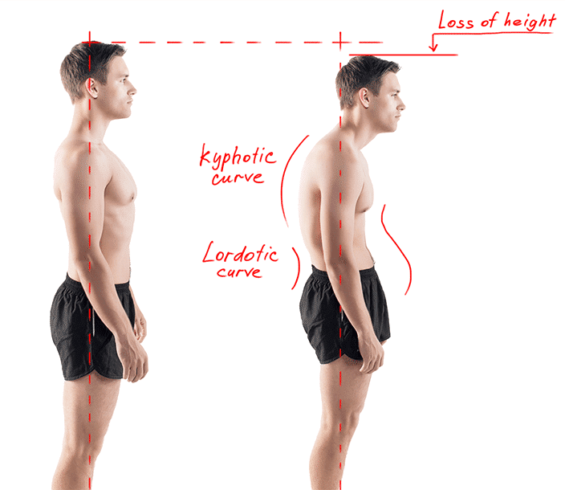
Postural kyphosis
  ‘Poor’ posture
  Can correct by ‘standing up straight’
  More common in teenage years
    Females > males
  Usually painfree but can be a sign of Ankylosing Spondylitis
  Poor posture does not always cause pain!

Slide 33
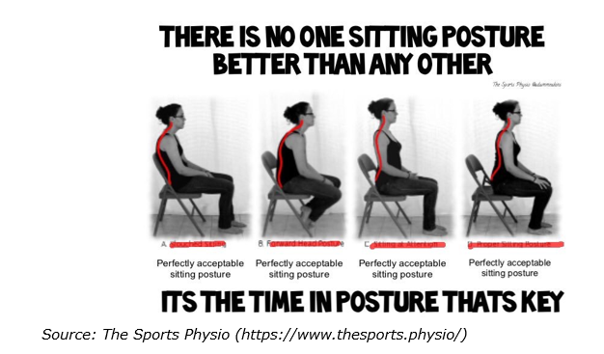
Swain CT, Pan F, Owen PJ, Schmidt H, Belavy DL. No consensus on causality of spine postures or physical exposure and low back pain: A systematic review of systematic reviews. Journal of biomechanics. 2020 Mar 26;102:109312.

Slide 34
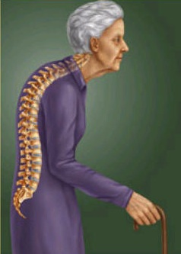
Postural degeneration
  Degenerative changes to
    Discs
    Vertebrae
    Facet joints
    Muscles
  Causes increase load on anterior vertebrae and spine extensors
  Decreases mobility of thoracic spine further increasing kyphosis
  Early intervention is important
    Extensor strengthening
    Manual therapy and therapeutic exercise

Slide 35
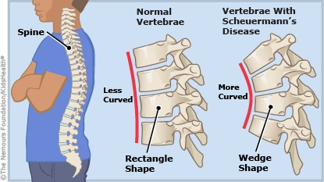
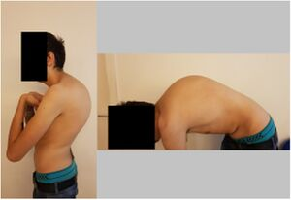
Scheuermann’s (disease) kyphosis
  “Juvenile kyphosis” - diagnosed in adolescents between 12-17 years old
  Developed large wedge shaped vertebrae and discs
  Believed to be hereditary
  ̴50% cases cause back pain

Slide 36
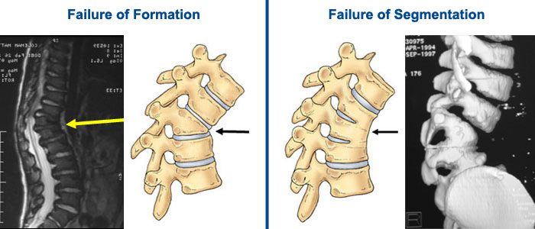

Congenital kyphosis
  Failure of formation or segmentation of vertebrae
  Occurs in first 6-8 weeks of embryonic life
  Unknown cause – genetic ‘mistake’

Slide 37
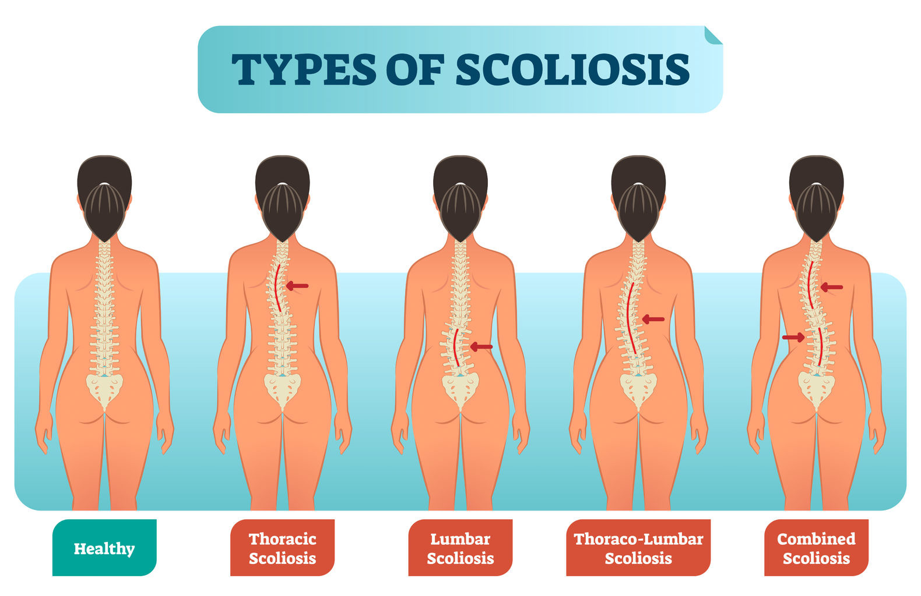

Slide 38
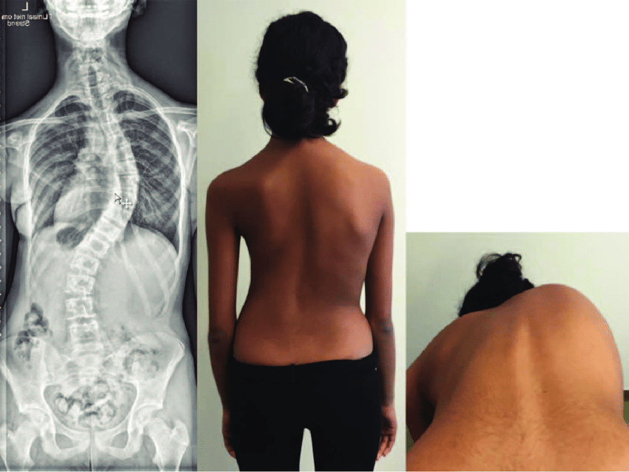
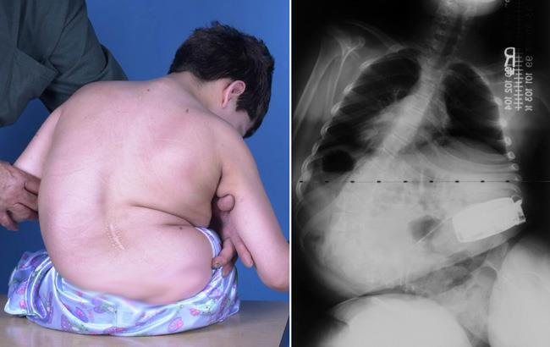
Idiopathic scoliosis
  >80% scoliosis – cause is unknown
  Usually occurs between 10-14 years old
  Growth can worsen scoliosis
Congenital scoliosis
  Misshaped vertebrae
  Identified from early infancy
  Watch and wait approach
Neuromuscular scoliosis
  Weak and imbalanced muscles as a results of a neurological condition
    Cerebral palsy
  Will usually continue to get worse
  Surgery recommended at 50°, breathing affected at 80°

Slide 39
Thoracic spine injuries
Thoracic spine injuries are less common than Lx and Cx
  Due to rigidity and stability
  Higher force needed to sustain injury
Due to high force needed injury can be more severe!
  Narrow vertebral canal spinal cord damage
Due to low incidence rate, Tx injuries are missed!

Slide 40
BPS model
Group task
Identify 1 biological, psychological and societal factors of thoracic pathology/pain
Provide examples of how a physiotherapist could help towards each factor.
Case notes

Slide 41
Biological Factors
Joint stiffness (hypomobility)
  Common with kyphosis or costovertebral dysfunction
Muscular imbalance
  Weak extensors – short pectorals
Structural abnormalities
  Scheuermann's disease
Neural irritation
Pain mechanisms

Slide 42
Psychological Factors
Body image concerns
  Hunched back, tall stature, breast size (macromastia)
Fear avoidance behavours
  Anxiety over movements or posture worsening pain
Stress
  Increase in pain perception and muscle tension
Breathing related anxiety

Slide 43
Societal Factors
Occupational demands
  Desk job, prolonged sitting/thoracic flexion
Lifestyle
  Sedentary habits, lack of exercise
Cultural perceptions of posture
  Historic societal emphasis on good/bad posture can increase psychological distress

Slide 44

Thoracic Quiz

